Slide 1
Introduction to C++ week 1

Slide 2
Procedural versus Object-Oriented Programming
Procedural programming focuses on the process/actions that occur in a program. The program starts at the beginning, does something, and ends.
Object-Oriented programming is based on the data and the functions that operate on it. Objects are instances of abstract data types that represent the data and its functions

Slide 3
Key Point
An object or class contains the data and the functions that operate on that data. Objects are similar to structs but contain functions, as well.

Slide 4
Object-Oriented Programming Terminology
class: like a struct (allows bundling of related variables), but variables and functions in the class can have different properties than in a struct
object: an instance of a class, in the same way that a variable can be an instance of a struct

Slide 5
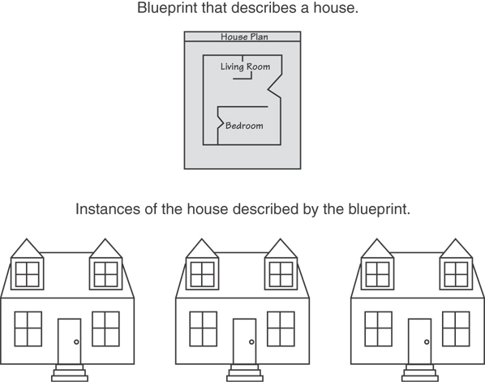
Classes and Objects
A Class is like a blueprint and objects are like houses built from the blueprint

Slide 6
Object-Oriented Programming Terminology
attributes: members of a class
methods or behaviors: member functions of a class

Slide 7
Creating a Class
Objects are created from a class
Format:
class ClassName
{
declaration;
declaration;
};

Slide 8
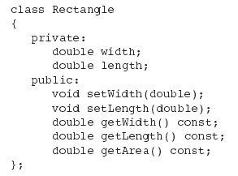
Classic Class Example

Slide 9
Access Specifiers
Used to control access to members of the class
public: can be accessed by functions outside of the class
private: can only be called by or accessed by functions that are members of the class
In the example on the next slide, note that the functions are prototypes only

Slide 10
Class Example

Slide 11
Access Specifiers
Private Members
Public Members

Slide 12
Access Specifiers (continued)
Can be listed in any order in a class
Can appear multiple times in a class
If not specified, the default is private

Slide 13

Using const With Member Functions
const appearing after the parentheses in a member function declaration specifies that the function will not change any data in the calling object.

Slide 14
Defining a Member Function
When defining a member function:
Put prototype in class declaration
Define function using class name and scope resolution operator (::)
int Rectangle::setWidth(double w)
{
width = w;
}

Slide 15
Global Functions
Functions that are not part of a class, that is, do not have the Class::name notation, are global. This is what we have done up to this point.

Slide 16
Defining an Instance of a Class
An object is an instance of a class
Defined like structure variables:
Rectangle r;
Access members using dot operator:
r.setWidth(5.2);
cout << r.getWidth();
Compiler error if you attempt to access a private member using dot operator
Notes:
Show “Rectangle” class program.

Slide 17
Pointers to Objects
Can define a pointer to an object:
Rectangle *rPtr;
Can access public members via pointer:
rPtr = &otherRectangle;
rPtr->setLength(12.5);
cout << rPtr->getLength() << endl;

Slide 18
Dynamically Allocating Objects
Rectangle *r1;
r1 = new Rectangle();
This allocates a rectangle and returns a pointer to it. Then:
r1->setWidth(12.4);

Slide 19
Private Members
Making data members private provides data protection
Data can be accessed only through public functions
Public functions define the class’s public interface

Slide 20
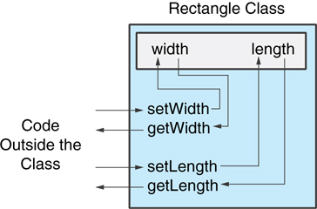
Private Members
Code outside the class must use the class's public member functions to interact with the object.

Slide 21
Inline Member Functions
Member functions can be defined
inline: in class declaration
after the class declaration
Inline appropriate for short function bodies:
int getWidth() const { return width; }

Slide 22
Tradeoffs – Inline vs. Regular Member Functions
Regular functions – when called, compiler stores return address of call, allocates memory for local variables, etc.
Code for an inline function is copied into program in place of call – larger executable program, but no function call overhead, hence faster execution

Slide 23
Constructors
Member function that is automatically called when an object is created
Purpose is to construct an object and do initialization if necessary
Constructor function name is class name
Has no return type specified
(What is the real return type?)

Slide 24
Default Constructors
A default constructor is a constructor that takes no arguments.
If you write a class with no constructor at all, C++ will write a default constructor for you, one that does nothing.
A simple instantiation of a class (with no arguments) calls the default constructor:
Rectangle r;

Slide 25
Passing Arguments to Constructors
To create a constructor that takes arguments:
indicate parameters in prototype: Rectangle(double, double);
Use parameters in the definition: Rectangle::Rectangle(double w, double len) { width = w; length = len; }

Slide 26
Passing Arguments to Constructors
You can pass arguments to the constructor when you create an object:
Rectangle r(10, 5);

Slide 27
More About Default Constructors
If all of a constructor's parameters have default arguments, then it is a default constructor. For example:
Rectangle(double = 0, double = 0);
Creating an object and passing no arguments will cause this constructor to execute: Rectangle r;

Slide 28
Classes with No Default Constructor
When all of a class's constructors require arguments, then the class has NO default constructor
When this is the case, you must pass the required arguments to the constructor when creating an object

Slide 29
Destructors
Member function automatically called when an object is destroyed
Destructor name is ~classname, e.g., ~Rectangle
Has no return type; takes no arguments
Only one destructor per class, i.e., it cannot be overloaded
If constructor allocates dynamic memory, destructor should release it

Slide 30
Constructors, Destructors, and Dynamically Allocated Objects
When an object is dynamically allocated with the new operator, its constructor executes: Rectangle *r = new Rectangle(10, 20);
When the object is destroyed, its destructor executes: delete r;

Slide 31
Overloading Constructors
A class can have more than one constructor Overloaded constructors in a class must have different parameter lists:
Rectangle(); Rectangle(double);
Rectangle(double, double);

Slide 32
Only One Default Constructor and One Destructor
Do not provide more than one default constructor for a class: one that takes no arguments and one that has default arguments for all parameters
Square();
Square(int = 0); // will not compile
Since a destructor takes no arguments, there can only be one destructor for a class

Slide 33
Member Function Overloading
Non-constructor member functions can also be overloaded:
void setCost(double);
void setCost(char *);
Must have unique parameter lists as for constructors

Slide 34
Using Private Member Functions
A private member function can only be called by another member function
It is used for internal processing by the class, not for use outside of the class
If you wrote a class that had a public sort function and needed a function to swap two elements, you’d make that private

Slide 35
Arrays of Objects
Objects can be the elements of an array:
Rectangle rooms[8];
Default constructor for object is used when array is defined

Slide 36
Arrays of Objects
Must use initializer list to invoke constructor that takes arguments:
Rectangle rArray[3]={Rectangle(2.1,3.2), Rectangle(4.1, 9.9),
Rectangle(11.2, 31.4)};

Slide 37
Arrays of Objects
It isn't necessary to call the same constructor for each object in an array:
Rectangle rArray[3]={Rectangle(2.1,3.2), Rectangle(),
Rectangle(11.2, 31.4)};

Slide 38
Accessing Objects in an Array
Objects in an array are referenced using subscripts
Member functions are referenced using dot notation:
rArray[1].setWidth(11.3);
cout << rArray[1].getArea();

